Slide 1


Amazon Volatility Pattern Analysis

Slide 2
Objective:
Download intraday (5-min interval) data for any major tech stock ( of last 1 week only)
Calculate and visualize:
Rolling volatility windows
Volume-weighted average price (VWAP)
Moving averages (20 and 50 period)
Identify unusual trading patterns

Slide 3
Step by Step procedure
Firstly I installed yfinance(Yahoo Finance) library in my Jupiter notebook using pip install yfinance.
This my first time using this library so had install it and see how to implement it on jupyter notebook.
While writing the code I had to give it duration interval I need the stock data at and for which timeframe .
I chose 5 min interval given in question to us but I chose timeframe for last 5 days as code wasn’t taking 7d command and asked for 5 d .

Slide 4
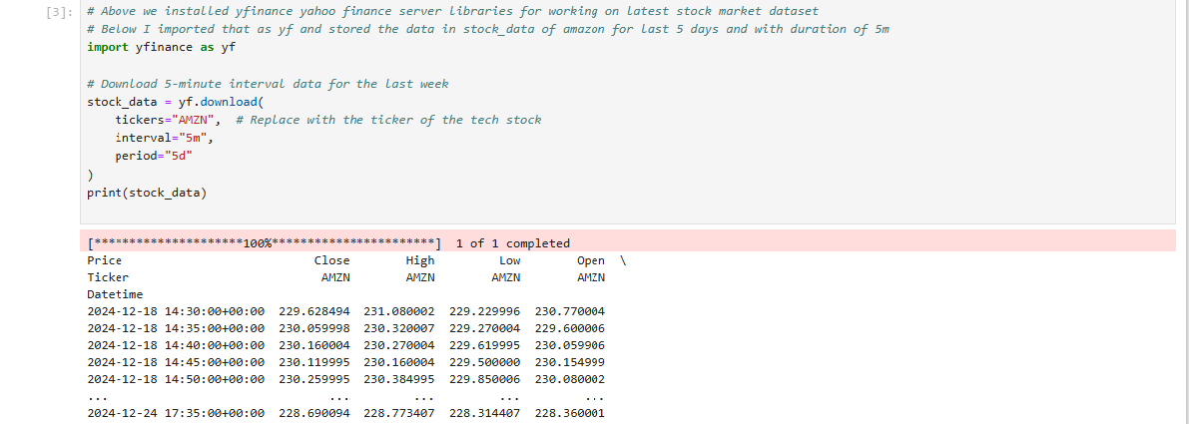
Code :

Slide 5
Next step:
After that I did use some codes on the dataset to its type, column what story it is telling
It has columns like Price Close High Low Open Volume
I saw top 5 using head() and checked for missing values there were none
So I did some visualization on dataset to find some hidden patterns in the dataset
Also describe() function was used on the dataset to correlation between the elements

Slide 6
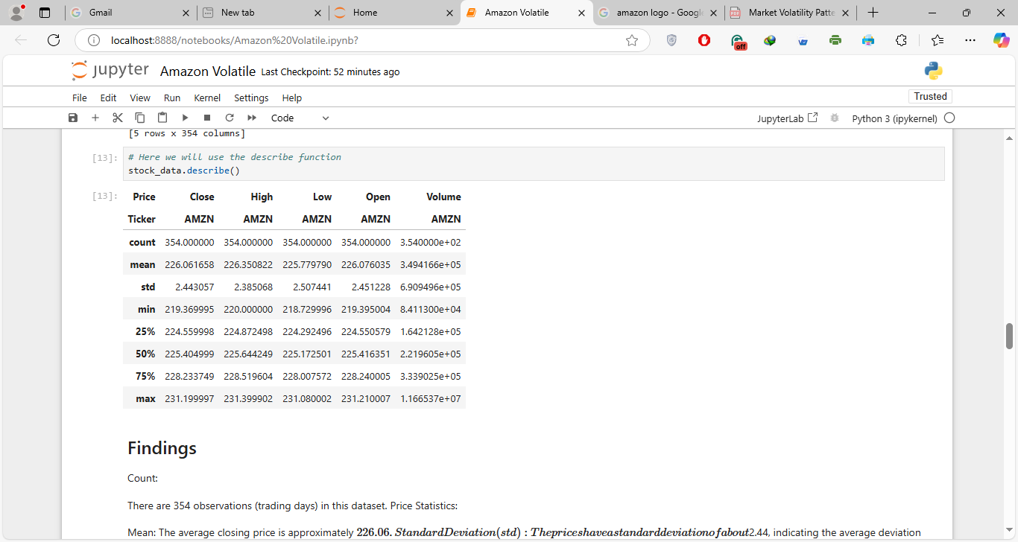
Describe on Dataset

Slide 7
Findings
Price Statistics:Mean: The average closing price is approximately $226.06.Standard Deviation (std): The prices have a standard deviation of about $2.44, indicating the average deviation from the mean price.Minimum: The lowest closing price recorded is $219.37.Maximum: The highest closing price recorded is $231.20.Percentiles:25th Percentile (Q1): 25% of the closing prices are below $224.56.50th Percentile (Median): The median closing price is $225.40, meaning half of the closing prices are below this value.75th Percentile (Q3): 75% of the closing prices are below $228.23.High, Low, Open Prices:The high, low, and open prices follow a similar pattern to the closing prices, with their respective means, standard deviations, and ranges provided.The average high price is approximately $225.78, while the average low price is around $226.08.Volume:The average trading volume is approximately 349,416 shares, with a maximum volume of over 11.6 million shares, indicating significant trading activity on certain days.InsightsThe relatively low standard deviation compared to the mean price suggests that the stock price has been relatively stable over the observed period.

Slide 8
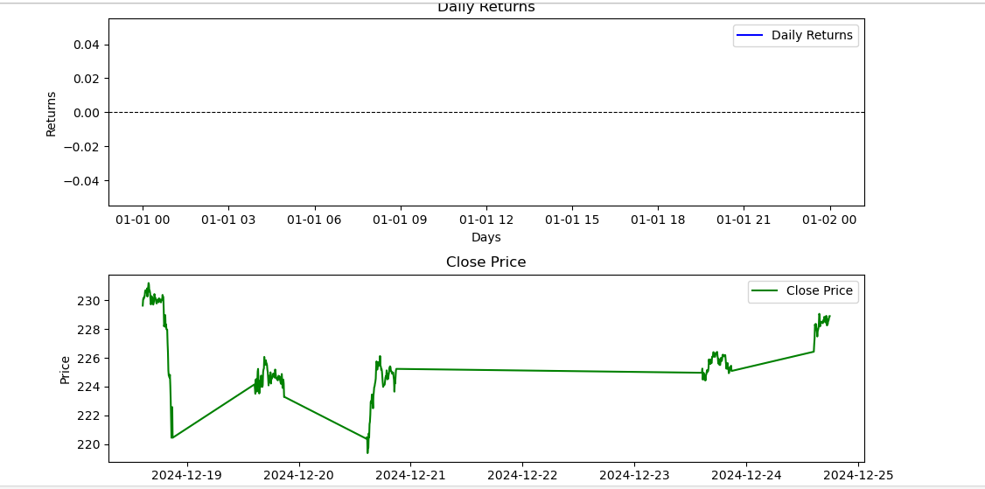
Graphical Distribution

Slide 9
Findings
1. Daily Returns PlotY-axis: The "Returns" axis represents the daily percentage change in stock price.X-axis: The "Days" axis displays time on an hourly scale (e.g., 01-01 00, 01-01 03, etc.), suggesting that the data is intraday rather than end-of-day for a specific date range.Observation:The daily returns fluctuate very closely around zero, with a maximum return slightly above 0.04 and a minimum slightly below -0.04.This suggests low volatility in daily percentage changes during this time period.Insight: Such low volatility could indicate that the stock price remained relatively stable over the observed period. This stability could be typical of large-cap stocks like Amazon, depending on market conditions.2. Close Price PlotY-axis: The "Price" axis represents the stock's closing price in dollars.X-axis: The time is displayed in hours (same as the Daily Returns plot), showing intraday price changes.Observation:The stock price fluctuates between approximately $224 and $230.There are sharp movements (spikes and drops), but the price stabilizes for certain periods before increasing again towards the end.These changes may represent market reactions to events (e.g., earnings announcements, news, or investor sentiment).

Slide 10
Further Findings from the Graph
1. Daily Returns - A Zero-Centric Trend-A fascinating trend in the daily returns is how tightly they cluster around 0, with only occasional de-viations beyond ±0.04 (4%). This points to a mean-reverting pattern, where returns tend to snap back to zero after slight positive or negative fluctuations.What’s particularly interesting is that if this behavior persists over multiple periods, it might suggest that Amazon's stock is heavily traded with efficient price corrections—possibly influenced by algorithmic or high-frequency trading. This kind of tight clustering is something you’d expect in highly liquid stocks like Amazon.

Slide 11
2. Close Price – Intraday Resistance and SupportLooking at the close price, the stock has some sharp drops—like the one early on (around 01-01 03)—but it quickly stabilizes and then moves higher. This hints at a potential support level around $224. Each time the price nears this point, buyers seem to step in, preventing further declines.On the flip side, there’s also a resistance level around $230. Toward the end of the chart, the price finally breaks through this level, showing bullish momentum. This kind of price behavior often reflects traders reacting to key thresholds—whether psychological or technical—that influence intraday movements.
3. Sudden Spikes - Potential AnomaliesThere are also moments of sharp price movement in the close price chart that stand out. For example:A steep drop early on (~01-01 03), followed by a quick recovery.Later, a noticeable upward breakout toward the end of the timeline.These sudden shifts could be tied to external events like news releases, earnings announcements, or large institutional trades (block trades). The drop and recovery might reflect a market overreaction to some information that was quickly corrected. Similarly, the breakout could signal a positive catalyst driving buying momentum. Pinpointing the exact timestamps and matching them with news or market events could provide some answers.

Slide 12
Conclusion
Key Unique Takeaways:
Mean reversion behavior in daily returns suggests a highly liquid stock with efficient price corrections.
Clear support (~$224) and resistance (~$230) levels highlight technical trading activity or psychological thresholds.
The sharp spikes and breakouts likely indicate external market events (news or trades) influencing intraday movements.
The use of hourly data granularity provides unique insights into intraday momentum and behavior, such as the end-of-day upward movement.

